Slide 1
Isogeny-based cryptography
PQ Crypto mini-school
Academia Sinica
Taiwan, 27-28 June 2018
$$E_{2}$$
Wouter Castryck
$$E_{1}$$

Slide 2
Quick overview
Isogeny-based cryptography = new kind of elliptic curve cryptography,
supposed to be resistant against quantum computers
classical elliptic curve cryptography
isogeny-based cryptography
$$P_{2}$$
$$E_{2}$$
$$P_{1}$$
$$E_{1}$$
based on hidden relation between two points on an elliptic curve
based on hidden relation between two elliptic curves in an isogeny class

Slide 3
Quick overview
Goal: to make a quick chronological tour, with a near exclusive focus on key exchange.
classical
1976
Diffie – Hellman:
Key exchange using exponentiation in groups
1985
Koblitz, Miller:
Use elliptic curves, i.e., groups of the form $E\left(F_{p}\right),+$
1994
Shor:
Polynomial-time quantum algorithm

Slide 4
Quick overview
Goal: to make a quick chronological tour, with a near exclusive focus on key exchange.
isogeny 1
1990
a.o. Brassard – Yung:
Generalize ‘exponentiation in groups’ to ‘actions of groups’
1997
Couveignes (indep. Stolbunov – Rostovtsev in 2004):
Use isogeny-based group actions
2003
a.o. Kuperberg:
Subexponential-time quantum algorithm

Slide 5
Quick overview
Goal: to make a quick chronological tour, with a near exclusive focus on key exchange.
isogeny 2
2006
Charles – Goren – Lauter:
Build hash function from supersingular isogeny graph
2010
Jao – De Feo:
Build key exchange from supersingular isogeny graph

Slide 6
Part I:
Classical elliptic curve Diffie-Hellman

Slide 7
Groups
A group $G$ is a set with a composition law $⋅ :G×G→G :\left(g_{1},g_{2}\right)↦g_{1}⋅g_{2}$ satisfying
1) associativity: for all $g_{1},g_{2},g_{3}∈G$ one has $\left(g_{1}⋅g_{2}\right)⋅g_{3}=g_{1}⋅\left(g_{2}⋅g_{3}\right)$
2) there exists a neutral element $e∈G$ for which $e⋅g=g⋅e$ for all $g∈G$
3) for all $g∈G$ there is an inverse $g^{−1}∈G$ such that $g⋅g^{−1}=g^{−1}⋅g=e$
If $g_{1}⋅g_{2}=g_{2}⋅g_{1}$ for all $g_{1},g_{2}∈G$ then the group is called commutative or abelian.
Exponentiation: if $a∈Z$ and $g∈G$ then
$g^{a}≔g⋅g⋅…⋅g$ or $g^{a}:=g^{−1}⋅g^{−1}⋅…⋅g^{−1}$
$a$ times
if $a≥0$
$|a|$ times
if $a<0$

Slide 8
Groups
Important: if the group law can be computed efficiently, then so can exponentiation.
Toy example: we can replace the 15 multiplications in
$g^{16}=g⋅g⋅g⋅g⋅g⋅g⋅g⋅g⋅g⋅g⋅g⋅g⋅g⋅g⋅g⋅g$
by the 4 squarings in
General method:
$a=101100010…0101$
$${g^{16}=\left({\left({\left(g^{2}\right)}^{2} \right)}^{2}\right)}^{2}$$
$${\left({\left({\left({\left({\left({\left({\left(g^{2}\right)}^{2}⋅g \right)}^{2}⋅g\right)}^{2}\right)}^{2} \right)}^{2} \right)}^{2}⋅g\right)}^{2}$$
$${\left({\left({\left({\left({\left({\left(g^{2}\right)}^{2}⋅g \right)}^{2}⋅g\right)}^{2}\right)}^{2} \right)}^{2} \right)}^{2}⋅g$$
$${\left({\left({\left({\left({\left(g^{2}\right)}^{2}⋅g \right)}^{2}⋅g\right)}^{2}\right)}^{2} \right)}^{2}$$
$${\left({\left({\left({\left(g^{2}\right)}^{2}⋅g \right)}^{2}⋅g\right)}^{2}\right)}^{2}$$
$${\left({\left({\left(g^{2}\right)}^{2}⋅g \right)}^{2}⋅g\right)}^{2}$$
$${\left({\left(g^{2}\right)}^{2}⋅g \right)}^{2}⋅g$$
$${\left(g^{2}\right)}^{2}⋅g$$
$$g^{2}$$
$$g$$
square
square
square
square
square and multiply
square and multiply
square and multiply
square

Slide 9
Groups
Important: if the group law can be computed efficiently, then so can exponentiation.
Toy example: we can replace the 15 multiplications in
$g^{16}=g⋅g⋅g⋅g⋅g⋅g⋅g⋅g⋅g⋅g⋅g⋅g⋅g⋅g⋅g⋅g$
by the 4 squarings in
General method:
$a=101100010…0101$
Exercise:
Verify that this computes $g^{a}$ using $O(\log{|a|})$ multiplications/squaring, as opposed to $O(|a|)$.
$${g^{16}=\left({\left({\left(g^{2}\right)}^{2} \right)}^{2}\right)}^{2}$$

Slide 10
Groups
Important: if the group law can be computed efficiently, then so can exponentiation.
Toy example: we can replace the 15 multiplications in
$g^{16}=g⋅g⋅g⋅g⋅g⋅g⋅g⋅g⋅g⋅g⋅g⋅g⋅g⋅g⋅g⋅g$
by the 4 squarings in
General method:
$a=101100010…0101$
Additive notation:
Sometimes we write $+$ instead of $⋅$ , in which case we write
$[a]g$ or simply $ag$ instead of $g^{a}$.
Square-and-multiply $⇒$ double-and-add
$${g^{16}=\left({\left({\left(g^{2}\right)}^{2} \right)}^{2}\right)}^{2}$$

Slide 11
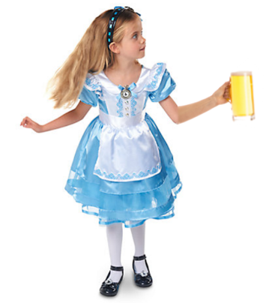
1976: Diffie-Hellman key exchange from exponentiation in groups
group $G,⋅$
$$g∈G$$
$$a∈Z$$
$$g^{a}$$
$$b∈Z$$
$$g^{b}$$
shared secret:
$${{(g}^{b})}^{a}=g^{ab}={{(g}^{a})}^{b}$$

Slide 12
1976: Diffie-Hellman key exchange from exponentiation in groups
Key features:
Practicality: given $a∈Z$ and $g∈G$, can efficiently compute $g^{a}$.
 thanks to square-and-multiply (if group operation is efficient)
Security: based on the discrete logarithm problem, i.e.,
given $g^{a}∈G$ and $g∈G$, determine some corresponding $a$.
 hard in certain groups (conjecturally and prequantum)

Slide 13
Diffie and Hellman’s choice:
Example:
$$G=F_{2^{200}−75}^{×}$$
$$g=123456789$$
Let $p$ be a prime number.
Consider the finite field $F_{p}=GF\left(p\right)$.
Then let:
$G=F_{p}^{×}=F_{p}∖\left\{0\right\}$ equiped with multiplication
$g∈G$ a generator
Computing discrete logarithms in finite fields is indeed hard! (Gauss, Jacobi, Kraitchik)
Still alive, but recommended size of $p$ grew from 200 bits to 3072 bits
subexponential-time algorithm: NFS with complexity $L_{p}(1/3)$
faster computers

Slide 14
1985: Koblitz and Miller suggest to use elliptic curves
Let $p>2$ be a prime number. Consider the finite field $F_{p}$.
An elliptic curve $E/F_{p}$ is an equation of the form
$$y^{2}=f(x)$$
where $f\left(x\right)∈F_{p}\left[x\right]$ is a squarefree cubic.
algebraic closure
Typical graph over $R$
The set of points is
$E=\left\{solutions in {\overline{F}}_{p}^{2} to y^{2}=f\left(x\right)\right\}∪\left\{∞\right\}$.
The set of rational points is
$E(F_{p})=\left\{solutions in F_{p}^{2} to y^{2}=f\left(x\right)\right\}∪\{∞\}$.

Slide 15
1985: Koblitz and Miller suggest to use elliptic curves
Group structure: tangent and chord arithmetic
$$P_{2}$$
$$P_{1}$$
$$P_{1}+P_{2}$$

Slide 16
1985: Koblitz and Miller suggest to use elliptic curves
Group structure: tangent and chord arithmetic
$$P_{1}$$
$$2P_{1}$$

Slide 17
1985: Koblitz and Miller suggest to use elliptic curves
Group structure: tangent and chord arithmetic
$$P_{2}$$
$$P_{1}$$
$$P_{1}$$
$$P_{1}+P_{2}=∞$$

Slide 18
1985: Koblitz and Miller suggest to use elliptic curves
Group structure: tangent and chord arithmetic
Exercise: prove explicit formulas for
$P_{i}=(x_{i}, y_{i})$ $f\left(x\right)=c_{0}x^{3}+…+c_{3}$
$λ=\frac{y_{2}−y_{1}}{x_{2}−x_{1}}$ (or $λ=\frac{f′(x_{1})}{2y_{1}}$ if $P_{1}=P_{2}$)
If division by 0 then $P_{1}+P_{2}=∞$.
Else $P_{1}+P_{2}=(x_{3},y_{3})$ where
$\left\{\begin{aligned}x_{3}=λ^{2}+{c_{1}}/{c_{0}}−x_{1}−x_{2}, \\ y_{3}=−y_{1}−λ\left(x_{3}−x_{1}\right). \end{aligned}\right.$
$$P_{2}$$
$$P_{1}$$
$$P_{1}+P_{2}$$

Slide 19
1985: Koblitz and Miller suggest to use elliptic curves
elliptic curve $E/F_{p}$
$$P∈E\left(F_{p}\right)$$
$$a∈Z$$
$$aP$$
$$b∈Z$$
$$bP$$
shared secret:
$$a\left(bP\right)=abP=b(aP)$$

Slide 20
1985: Koblitz and Miller suggest to use elliptic curves
Key features:
Practical: given $a∈Z$ and $P∈E\left(F_{p}\right)$, can efficiently compute $aP$.
 thanks to explicit formulas and double-and-add
Secure: the discrete logarithm problem on elliptic curves over finite fields is hard
 no subexponential-time prequantum algorithms known
Compact keys: recommended size of $p$ is 256 bits

Slide 21
Diffie-Hellman key exchange from exponentiation in groups
Post-quantum?
The DLP is an instance of the hidden subgroup problem.
Hidden subgroup problem:
Let $G$ be a group and $H⊆G$ a subgroup.
Assume to be given a map $f:G→S$ that is constant exactly on the cosets of $H$ in $G$.
Find an explicit description of $H$.
$$G$$
$$g_{1}⋅H$$
$$g_{2}⋅H$$
$$g_{3}⋅H$$
$$…$$
$$g_{r}⋅H$$
Given $h=g^{a}$, to find $a∈Z_{N}$ with $N=ord(g)$ can be seen as the HSP associated with
$f:Z_{N}×Z_{N}→G:\left(λ,μ\right)↦g^{λ}h^{−μ}$
constant on cosets of $ker f=〈\left(a,1\right)〉$

Slide 22
Diffie-Hellman key exchange from exponentiation in groups
Post-quantum?
The DLP is an instance of the hidden subgroup problem.
Hidden subgroup problem:
Let $G$ be a group and $H⊆G$ a subgroup.
Assume to be given a map $f:G→S$ that is constant exactly on the cosets of $H$ in $G$.
Find an explicit description of $H$.
$$G$$
$$g_{1}⋅H$$
$$g_{2}⋅H$$
$$g_{3}⋅H$$
$$…$$
$$g_{r}⋅H$$
Shor (1994, a posteriori interpretation by Jozsa 1998):
HSP in commutative groups can be solved in polynomial time on a quantum computer.

Slide 23
Diffie-Hellman key exchange from exponentiation in groups
Post-quantum?
The DLP is an instance of the hidden subgroup problem.
Hidden subgroup problem:
Let $G$ be a group and $H⊆G$ a subgroup.
Assume to be given a map $f:G→S$ that is constant exactly on the cosets of $H$ in $G$.
Find an explicit description of $H$.
$$G$$
$$g_{1}⋅H$$
$$g_{2}⋅H$$
$$g_{3}⋅H$$
$$…$$
$$g_{r}⋅H$$
Given $h=g^{a}$, to find $a∈Z_{N}$ with $N=ord(g)$ can be seen as the HSP associated with
$f:Z_{N}×Z_{N}→G:\left(λ,μ\right)↦g^{λ}h^{−μ}$
commutative!
constant on cosets of $ker f=〈\left(a,1\right)〉$

Slide 24
Part II:
Diffie-Hellman key exchange from commutative group actions

Slide 25
Group actions
An action of a group $G$ on a set $X$ is a map
$$G×X→X:\left(g,x\right)↦g∗x$$
obeying the rules $e∗x=x$ and $g_{1}∗\left(g_{2}∗x\right)=\left(g_{1}⋅g_{2}\right)∗x$ for all $g_{1},g_{2}∈G.$
Further terminology
The group action is called transitive if for all $x,y∈X$ there is a $g∈G$ such that $y=g∗x$.
The group action is free if $g∗x=x$ implies that $g=e$.
Under these assumptions $X$ is called a principal homogeneous space for $G$, or a $G$-torsor.

Slide 26
Examples of group actions (I)
Important example:
Exponentiation:
$$G=Z_{N}^{×},⋅$$
$X=$ group of order $N$, $⋅$
so the set is incidentally a group here
action: $\overline{a}∗g≔g^{a}$
Note that indeed:
$$\overline{1}∗g=g^{1}=g$$
$${\overline{a}}_{1}∗\left({\overline{a}}_{2}∗g\right)={\overline{a}}_{1}∗g^{a_{2}}={\left(g^{a_{2}}\right)}^{a_{1}}=g^{a_{1}a_{2}}={\overline{a}}_{1}{\overline{a}}_{2}∗g$$

Slide 27
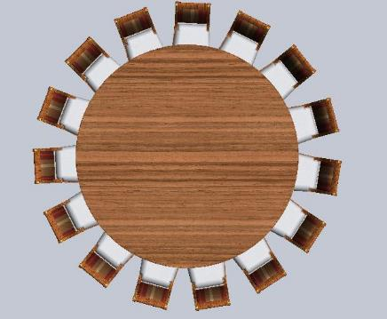
Examples of group actions (II)
Rotation:
$$G=Z_{N},+$$
$$N−1$$
0
1
$$X=\{N chairs of a round table\}$$
2
action: $\overline{a}∗c≔\left(c+a\right) mod N$
(rotation over $a$ chairs)
3
4
5

Slide 28
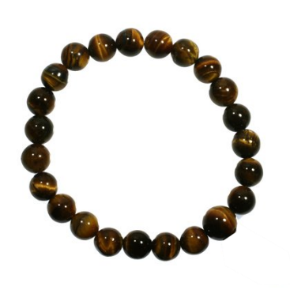
4
5
Examples of group actions (III)
3
2
$$G=Z_{N},+$$
1
0
from this we build a new group
by adjoining a formal symbol $[r]$.
$$N−1$$
Dihedral group
$$Dih\left(Z_{N}\right)=\left\{ \overline{a},\overline{a}+[r] \right|\overline{a}∈Z_{N} \}$$
Rules:
$$\left[r\right]+[r]=0$$
Dihedral action:
$$\overline{a}+\left[r\right]=[r]−\overline{a}$$
$$G={Dih(Z}_{N})$$
Example: one has
$$\left(\overline{7}+[r]\right)+\left(\overline{2}+[r]\right)=$$
$$X=\{N beads of a bracelet\}$$
$$\overline{7}+\left([r]+\overline{2}\right)+[r]=$$
action: $\overline{a}∗c≔\left(c+a\right) mod N$
$\left[r\right]∗c≔\left(N−1−c\right) mod N$
$$\overline{7}+\left(−\overline{2}+[r]\right)+[r]=\overline{5}$$

Slide 29
Examples of group actions (IV)
Let $p>2$ be a prime number and let
$E:y^{2}=f(x)$
be an elliptic curve over $F_{p}$. Let $N=|E\left(F_{p}\right)|$.
$$P$$
$$x_{0}$$
$$\overline{2}∗x_{0}$$
Kummer action:
$$G=Z_{N}^{×},⋅$$
$$X=P^{1}\left(F_{p}\right)=F_{p}∪\{∞\}$$
$$2P$$
action: $\overline{a}∗x_{0}≔x$-$coordinate$ of $aP$ where
$P∈E\left(F_{p}\right)∪E^{twist}(F_{p})$
is a point with $x$-coordinate $x_{0}$.

Slide 30
Diffie-Hellman key exchange using commutative group actions
commutative group $G,⋅$
acting on set $X$
$$x_{0}∈X$$
$$a∈G$$
$$a∗x_{0}$$
$$b∈G$$
$$b∗x_{0}$$
shared secret:
$$a∗\left(b∗x_{0}\right)=\left(a⋅b\right)∗x_{0}=b∗(a∗x_{0})$$

Slide 31
Diffie-Hellman key exchange using commutative group actions
Requisites:
Practicality: given $a∈G$ and $x_{0}∈X$, can efficiently compute $a∗x_{0}$.
Security: based on the vectorization problem, i.e.,
given $a∗x_{0}∈X$ and $x_{0}∈X$, determine some corresponding $a$.
Both requisites are non-trivial a priori!
(In particular, no square-and-multiply available in general.)
Exercise: Define a group action with the worst possible features, in that Alice and Bob should solve discrete logarithms for key exchange, while Eve can break the scheme by mere exponentiation.
Exercise: Let $N=pq$ be an RSA modulus. Define an action of $Z_{N},+$ so that the vectorization problem is equivalent to factoring the modulus.

Slide 32
Diffie-Hellman key exchange using commutative group actions
Three main `serious’ examples:
Classical Diffie-Hellman key exchange using exponentiation
practical thanks to square-and-multiply
$x$-coordinate only elliptic curve Diffie-Hellman using the Kummer action
practical thanks to differential addition (Montgomery ladder)
e.g., used in X25519
Couveignes—Rostovtsev—Stolbunov key exchange using the `CM torsor’
to be discussed very soon!

Slide 33
Diffie-Hellman key exchange using commutative group actions
Yes!
What about post-quantum?
Given $a∗x$, can finding $a∈G$ again be viewed as a hidden subgroup problem?
$G$ commutative $⇒$ can again define the (generalized) dihedral group
$$Dih\left(G\right)=\left\{ g,g⋅[r] \right| g∈G \}$$
by the rules ${\left[r\right]}^{2}=e$, $g⋅\left[r\right]=\left[r\right]⋅g^{−1}$.
Exercise: Verify that this defines a group and be sure you understand why $G$ should be commutative for this to work.

Slide 34
Diffie-Hellman key exchange using commutative group actions
Yes!
What about post-quantum?
Given $a∗x$, can finding $a∈G$ again be viewed as a hidden subgroup problem?
Then the function
$$f:Dih\left(G\right)→X:\left\{\begin{matrix}g & ↦ & g∗(a∗x) \\ g⋅[r] & ↦ & g∗x\end{matrix}\right.$$
is constant on cosets of $〈a⋅\left[r\right]〉$.
not commutative!
(Shor does not apply)
hidden subgroup!
Exercise: Verify this claim.

Slide 35
Diffie-Hellman key exchange using commutative group actions
Yes!
What about post-quantum?
Given $a∗x$, can finding $a∈G$ again be viewed as a hidden subgroup problem?
But… Kuperberg 2003: a subexponential time quantum algorithm for the hidden
subgroup problem in (generalized) dihedral groups
complexity $L_{|G|}(1/2)$
implied constants / concrete impact badly understood

Slide 36
Diffie-Hellman key exchange using commutative group actions
Main conclusions:
security relies on the discrete logarithm problem
prequantum: hard e.g. for $G=F_{p},⋅$ or $G=E\left(F_{p}\right),+$
postquantum: always falls prey to Shor’s polynomial-time algorithm
practicality comes (almost) for free thanks to square-and-multiply
exponentiation
security relies on the vectorization problem
prequantum: same examples, but also new ones
postquantum: always susceptible to Kuperberg’s $L_{|G|}(1/2)$ algorithm
but might defeat Shor’s algorithm (e.g. for CM torsor)
efficiency does not come for granted
general commu- tative group actions

Slide 37
Part III:
The CM torsor

Slide 38
The CM torsor
This is an action of a commutative group
$G=Cl\left(O\right),⋅$ (ideal class group of an imaginary quadratic order)
on a the set of the form
$$X={\left\{ elliptic curves E/{F_{p}} with End_{F_{p}}\left(E\right)≅O and prescribed \left|E\left(F_{p}\right)\right|\right\}}/{≅_{F_{p}}}$$
through isogenies.
$$X$$

Slide 39
The CM torsor
This is an action of a commutative group
$G=Cl\left(O\right),⋅$ (ideal class group of an imaginary quadratic order)
on a the set of the form
$$X={\left\{ elliptic curves E/{F_{p}} with End_{F_{p}}\left(E\right)≅O and prescribed \left|E\left(F_{p}\right)\right|\right\}}/{≅_{F_{p}}}$$
through isogenies.
So, what are…
imaginary quadratic orders?
endomorphism rings?
isogenies?
ideal class groups?
… and then wat is the CM torsor?

Slide 40
Imaginary quadratic orders
For this talk’s purposes, this is just a ring of the form
$$Z\left[\sqrt{−d}\right]=\left\{ a+b\sqrt{−d} | a,b∈Z \right\}$$
where $d>0$ is a squarefree integer. Best-known example: the Gaussian integers $Z[i]$.
E.g., in $Z\left[\sqrt{−3}\right]$ one has
$\left(3−\sqrt{−3}\right)⋅\left(−1+5\sqrt{−3}\right)=−3+15\sqrt{−3}+\sqrt{−3}−5⋅\left(−3\right)=12+16\sqrt{−3}$.
That’s it! *
* Remark: the ‘official’ definition of an imaginary quadratic order is slightly more general, and as a consequence of this and further sloppinesses, some of the statements below are only (100-$ε)$% precise.

Slide 41
Group homomorphisms
Recall: a homomorphism between two groups $G_{1},⋅$ and $G_{2},⋅$ is a map
$$φ:G_{1}→G_{2}$$
such that
$$φ\left(g⋅h\right)=φ\left(g\right)⋅φ(h)$$
for all $g,h∈G_{1}$.
Automatically satisfies: $φ\left(e_{G_{1}}\right)=e_{G_{2}}$ and $φ\left(g^{−1}\right)=φ{\left(g\right)}^{−1}$ for all $g∈G_{1}$.

Slide 42
Homomorphisms, isomorphisms, endomorphisms, isogenies
Let $E_{1}$ and $E_{2}$ be two elliptic curves over $F_{p}$.
In the context of elliptic curves, a homomorphism $φ:E_{1}→E_{2}$ is a map which is
algebraic, i.e., can be described in terms of rational functions
a group homomorphism, in particular $φ\left(∞\right)=∞$
this means that $φ\left(P+Q\right)=φ\left(P\right)+φ(Q)$ for all $P,Q∈E_{1}$.
Some facts:
If $φ\left(∞\right)=∞$ and $φ$ is algebraic, then it is automatically a homomorphism.
The kernel $\ker{φ=φ^{−1}\{∞\}}$ is either all of $E_{1}$ or a finite subset of $E_{1}$.
An isogeny $φ:E_{1}→E_{2}$ is a homomorphism with finite kernel.

Slide 43
Homomorphisms, isomorphisms, endomorphisms, isogenies
Example:
Let $p>2$ be a prime number. Let $a,b∈F_{p}$ satisfy $b\left(a^{2}−4b\right)≠0$. Then
$E_{1}:y^{2}=x^{3}+ax^{2}+bx$ and $E_{2}:y^{2}=x^{3}−2ax^{2}+\left(a^{2}−4b\right)x$
are elliptic curves over $F_{p}$ and they admit the map
$$φ:E_{1}→E_{2}:\left\{\begin{aligned}\left(0,0\right),∞↦∞ \\ \left(x_{1},y_{1}\right)↦\left(\frac{y_{1}^{2}}{x_{1}^{2}},y_{1}\left(\frac{x_{1}^{2}−b}{x_{1}^{2}}\right)\right) if x_{1}≠0\end{aligned}\right.$$
Thus $φ$ is a homomorphism with kernel $\left\{ \left(0,0\right), ∞ \right\}$. In particular it is an isogeny.
Exercise: Verify these claims.

Slide 44
Homomorphisms, isomorphisms, endomorphisms, isogenies
Simpler example:
Let $p>3$ be a prime number. Let $a,b∈F_{p}$ satisfy $4a^{3}+27b^{2}≠0$. Let $u∈F_{p}^{×}$. Then
$E_{1}:y^{2}=x^{3}+ax+b$ and $E_{2}:y^{2}=x^{3}+au^{4}x+bu^{6}$
are elliptic curves over $F_{p}$ and they admit the map
$$φ:E_{1}→E_{2}:\left\{\begin{aligned}∞↦∞ \\ \left(x_{1},y_{1}\right)↦\left(u^{2}x_{1},u^{3}y_{1}\right)\end{aligned}\right.$$
Then $φ$ is a homomorphism with kernel $\left\{ ∞ \right\}$. In particular it is again an isogeny.
will be called an isomorphism (see soon)

Slide 45
Homomorphisms, isomorphisms, endomorphisms, isogenies
Yet another example:
Let $p>3$ be a prime number. Consider the elliptic curve $E/F_{p}$ defined by
$y^{2}=x^{3}+x$.
Then the map
$$φ:E→E:\left\{\begin{aligned}∞↦∞ \\ \left(x_{1},y_{1}\right)↦\left(−x_{1},iy_{1}\right),\end{aligned}\right.$$
where $i∈{\overline{F}}_{p}$ is a square root of $−1$, is again an isogeny with kernel $\left\{ ∞ \right\}$.
will be called an endomorphism

Slide 46
Homomorphisms, isomorphisms, endomorphisms, isogenies
A homomorphism between an elliptic curve $E/F_{p}$ and itself is called an endomorphism.
Main examples:
Multiplication by an integer: $\left[m\right]:E→E:P↦mP$.
The Frobenius endomorphism:
$$π:E→E:\left\{\begin{aligned}∞↦∞ \\ \left(x_{1},y_{1}\right)↦\left(x_{1}^{p}, y_{1}^{p}\right)\end{aligned}\right.$$
Exercise: Using that
${\left(a+b\right)}^{p}=a^{p}+b^{p}$ for all ${a,b∈\overline{F}}_{p}$
$a^{p}=a$ for all $a∈F_{p}$
show that $π$ is a well-defined isogeny.

Slide 47
Homomorphisms, isomorphisms, endomorphisms, isogenies
A homomorphism whose kernel equals* the singleton $\{ ∞ \}$ is called in isomorphism.
Examples:
The negation map $\left[−1\right]:E→E:P↦−P$.
The isogeny
$$φ:E_{1}→E_{2}:\left\{\begin{aligned} ∞↦∞ \\ \left(x_{1},y_{1}\right)↦\left(u^{2}x_{1},u^{3}y_{1}\right)\end{aligned}\right.$$
we encountered two slides ago.
* Remark: in fact equality should hold when ‘taking into account multiplicities’.
In particular the Frobenius endomorphism $π$ is not an isomorphism.
For almost all homomorphisms (called separable) there are no multiplicities.

Slide 48
The endomorphism ring
The endomorphisms of an elliptic curve $E/F_{p}$ form a ring with
pointwise addition:
$$φ_{1}+φ_{2} :E→E :P↦φ_{1}\left(P\right)+φ_{2}(P)$$
multiplication by composition:
$$φ_{1}⋅φ_{2} :E→E :P↦φ_{1}\left(φ_{2}(P\right))$$
Exercise: Verify that all the ring axioms are satisfied.
We make a distinction between:
the ring of $F_{p}$-rational endomorphisms $End_{F_{p}}(E)$
the full ring of endomorphisms $End(E)$
i.e., can be described using coefficients in $F_{p}$
can be a strictly bigger ring (see example with $i=\sqrt{−1}$)

Slide 49
The endomorphism ring
Very remarkable fact:
$End_{F_{p}}(E)$ is isomorphic to an imaginary quadratic order, so it is a commutative ring!
It is known that the Frobenius endomorphism $π$ satisfies the characteristic equation
$$π^{2}−\left[t\right]π+\left[p\right]=0$$
where $t≔p+1−\left|E\left(F_{p}\right)\right|$ is called the trace of Frobenius and $d≔t^{2}−4p<0$.
Almost the good map: we have a well-defined inclusion
$$Z\left[\sqrt{−d}\right]↪End_{F_{p}}\left(E\right):\left\{\begin{aligned}m∈Z↦\left[m\right] \\ \sqrt{−d} ↦t−\left[2\right]⋅π\end{aligned}\right.$$
(in fact $End_{F_{p}}\left(E\right)$ is always slightly larger than this image, note $d$ need not be squarefree).
Exercise: verify this!

Slide 50
The endomorphism ring
As for the full ring of endomorphisms, one usually simply has
$End_{F_{p}}\left(E\right)=End(E)$.
If this is the case then our elliptic curve $E$ is called ordinary.
Exceptionally it can happen that the inclusion
$$End_{F_{p}}\left(E\right)⊆End(E)$$
is strict, in which case $E$ is called supersingular. In this case $End(E)$ is not commutative!
alternative characterization (if $p>3$):
$\left|E\left(F_{p}\right)\right|=p+1$

Slide 51
Ideal class group
Let $O=Z\left[\sqrt{−d}\right]$ be an imaginary quadratic order.
An ideal $I⊆O$ is the set of all $O$-linear combinations of a given set of elements of $O$.
Example: in $Z\left[\sqrt{−3}\right]$ we can consider the ideal
$〈 7, 2+\sqrt{−3} 〉≔\left\{ a7+b\left(2+\sqrt{−3}\right) | a,b∈Z\left[\sqrt{−3}\right] \right\}$.
A principal ideal is an ideal of the form $I=〈α〉$ for a single $α∈O$.
Possible to multiply ideals: if $I_{1},I_{2}⊆O$ are ideals then
$I_{1}⋅I_{2}≔〈 αβ | α∈I_{1} and β∈I_{2} 〉$.

Slide 52
Ideal class group
Call two ideals $I_{1},I_{2}⊆O$ equivalent if there exist $α,β∈O∖\{0\}$ such that
$〈α〉⋅I_{1}=〈β〉⋅I_{2}$,
i.e., if they are equal ‘modulo principal ideals’.
Exercise: show that equivalence is compatible with multiplication, i.e., if $I_{1}∼J_{1}$ and $I_{2}∼J_{2}$ then $I_{1}⋅I_{2}∼J_{1}⋅J_{2}$. So we can multiply equivalence classes!
Define the ideal class group of $O$ as
$$Cl\left(O\right)=\left\{ equivalence classes of nonzero ideals I⊆O \right\}, ⋅$$
Miracle: this is indeed a group, i.e., for every nonzero ideal $I⊆O$ there exists another nonzero ideal $J⊆O$ such that $I⋅J=〈α〉$ for some $α∈O∖\{0\}$.

Slide 53
The CM torsor
Another fact about isogenies:
Remember that an isogeny $φ:E_{1}→E_{2}$ has a finite kernel
$H=\ker{φ=φ^{−1}\left\{∞\right\}⊆E_{1}}$.
Then one can show:
Converse: for each finite subgroup $H⊆E_{1}$ there is isogeny $φ:E_{1}→E_{2}$ with kernel $H$.
If we take into account multiplicities (i.e., if we restrict to separable isogenies) then both $φ$ and $E_{2}$ are unique up to $F_{p}$-rational isomorphism. We write $φ_{H}:E_{1}→E_{1}/H$.

Slide 54
The CM torsor
Let $E/F_{p}$ be an elliptic curve with endomorphism ring $O=End_{F_{p}}\left(E\right)$.
Let $I⊆O$ be a non-zero ideal. Then one can define the subgroup
$$H_{I}=\bigcap_{α∈I}{\ker{α}}$$
and consider the associated separable isogeny
$φ_{I}:E→E/H_{I}$.
Premature version of the CM torsor: define $I∗E≔E/H_{I}$.

Slide 55
The CM torsor
Example: $I=〈[2],π−[1]〉$.
Then: $\ker\left[2\right]= E\left[2\right]=\left\{ P∈E | 2P=∞ \right\}$
$\ker\left(π−\left[1\right]\right)=\left\{ P∈E | π\left(P\right)=P \right\}=E(F_{p})$
$$H_{I}=\left\{ P∈E\left(F_{p}\right) | 2P=∞ \right\}$$
Recall: if $p>2$ and $a,b∈F_{p}$ satisfies $b\left(a^{2}−4b\right)≠0$ then we had isogeny from
$E_{1}:y^{2}=x^{3}+ax^{2}+b$x to $E_{2}:y^{2}=x^{3}−2ax^{2}+(a^{2}−4b)$x
with kernel $\left\{ \left(0,0\right), ∞ \right\}$.
If $a^{2}−4b$ is nonsquare then $H_{I}=\left\{ \left(0,0\right), ∞ \right\}$ and therefore $I∗E_{1}=E_{2}$.
Exercise: verify this! What if $a^{2}−4b$ is square?

Slide 56
The CM torsor
Can be shown:
If $I⊆O$ is a nonzero ideal and $End_{F_{p}}\left(E\right)=O$ then also
$End_{F_{p}}\left(I∗E\right)=O$,
so we can repeat. Moreover $I_{1}∗\left(I_{2}∗E\right)=\left(I_{1}⋅I_{2}\right)∗E$ for all non-zero ideals $I_{1},I_{2}⊆O$.
Tate: all isogenous elliptic curves have the same number of $F_{p}$-points.
Thus our premature version of the CM torsor can be viewed as an ‘action’ of
$$\left\{ nonzero ideals I⊆O \right\}, ⋅$$
on $X={\left\{ elliptic curves E/{F_{p}} with End_{F_{p}}\left(E\right)≅O and prescribed \left|E\left(F_{p}\right)\right|\right\}}/{≅_{F_{p}}}$

Slide 57
The CM torsor
To get our desired action of $Cl\left(O\right),⋅$ it suffices to remark that principal ideals act trivially:
$$I=〈α〉 ⇒ H_{I}=\ker{α} ⇒ φ_{I}:E→E/{H_{I}}≅E$$
where the isomorphism holds because $α$ is an endomorphism.
So we finally get our action:
$$X$$
$$Cl\left(O\right)$$
… can be shown to be free and transitive,
hence a torsor.

Slide 58
Part IV:
Couveignes-Rostovtsev-Stolbunov key agreement

Slide 59
Couveignes-Rostovtsev-Stolbunov key agreement
In 1997 Couveignes designed the first isogeny-based cryptosystem.
submitted to CRYPTO, rejected and never formally published
rediscovered by Rostovtsev and Stolbunov in 2004
Proposal: Diffie-Hellman key exchange using the CM torsor we just described.

Slide 60
Couveignes-Rostovtsev-Stolbunov key agreement
imaginary quadratic order $O$
ell. curve $E_{0}$ with $End_{F_{p}}\left(E_{0}\right)≅O$
$$I∈Cl(O)$$
$$I∗E_{0}$$
$$J∈Cl(O)$$
$$J∗E_{0}$$
shared secret:
$$I∗\left(J∗E_{0}\right)=\left(I⋅J\right)∗E_{0}=J∗(I∗E_{0})$$

Slide 61
Couveignes-Rostovtsev-Stolbunov key agreement
How to do this in practice? Remember: no square-and-multiply!
Idea: find enough ideals $I_{1},I_{2},I_{3},…,I_{r}$ whose action is easy to compute.
Ideal ideals:
$I_{j}=〈\left[ℓ_{j}\right],π−\left[1\right]〉$,
so that
$H_{I_{j}}=\left\{ P∈E\left[F_{p}\right] | ℓ_{j}P=∞ \right\}$.
In that case $E/H_{I_{j}}$ can be computed efficiently using Vélu’s formulae.
Assume that generic element of $Cl\left(O\right)$ is of the form $I_{1}^{e_{1}}⋅I_{2}^{e_{2}}⋅I_{3}^{e_{3}}⋯I_{r}^{e_{r}}$ for $0≤e_{i}≤λ$.
If $\left|Cl\left(O\right)\right|≈\sqrt{p}$ has bitlength $k$ then need $λ≈2^{k/r}$, so the larger $r$ the better.

Slide 62
Couveignes-Rostovtsev-Stolbunov key agreement
imaginary quadratic order $O$
ell. curve $E_{0}$ with $End_{F_{p}}\left(E_{0}\right)≅O$
easy ideals $I_{1},I_{2},…, I_{r}⊆O$
$$\left(a_{1},…,a_{r}\right)∈{\left\{0, …, λ\right\}}^{r}$$
$$I_{1}^{a_{1}}⋯I_{r}^{a_{r}}∗E_{0}$$
$$\left(b_{1},…,b_{r}\right)∈{\left\{0, …, λ\right\}}^{r}$$
$$I_{1}^{b_{1}}⋯I_{r}^{b_{r}}∗E_{0}$$
shared secret:
$$I_{1}^{a_{1}}⋯I_{r}^{a_{r}}∗\left(I_{1}^{b_{1}}⋯I_{r}^{b_{r}}∗E_{0}\right)=I_{1}^{a_{1}+b_{1}}⋯I_{r}^{a_{r}+b_{r}}∗E_{0}=I_{1}^{b_{1}}⋯I_{r}^{b_{r}}∗(I_{1}^{a_{1}}⋯I_{r}^{a_{r}}∗E_{0})$$

Slide 63
$$I_{1}$$
$$a_{1}=3$$
$$E_{0}$$

Slide 64
$$I_{1}$$
$$a_{1}=3$$
$$E_{0}$$

Slide 65
$$I_{1}$$
$$a_{1}=3$$
$$E_{0}$$

Slide 66
$$I_{1}$$
$$a_{1}=3$$
$${I_{1}^{3}∗E}_{0}$$
$$E_{0}$$

Slide 67
$$I_{2}$$
$$a_{2}=5$$
$${I_{1}^{3}∗E}_{0}$$
$$E_{0}$$

Slide 68
$$I_{2}$$
$$a_{2}=5$$
$$E_{0}$$

Slide 69
$$I_{2}$$
$$a_{2}=5$$
$$E_{0}$$

Slide 70
$$I_{2}$$
$$a_{2}=5$$
$$E_{0}$$

Slide 71
$$I_{2}$$
$$a_{2}=5$$
$$E_{0}$$

Slide 72
$$I_{2}$$
$$a_{2}=5$$
$$E_{0}$$
$${{I_{2}^{5}∗I}_{1}^{3}∗E}_{0}$$

Slide 73
$$I_{3}$$
$$a_{3}=2$$
$$E_{0}$$
$${{I_{2}^{5}∗I}_{1}^{3}∗E}_{0}$$

Slide 74
$$I_{3}$$
$$a_{3}=2$$
$$E_{0}$$

Slide 75
$$I_{3}$$
$$a_{3}=2$$
$$E_{0}$$
$${{{I_{3}^{2}∗I}_{2}^{5}∗I}_{1}^{3}∗E}_{0}$$

Slide 76
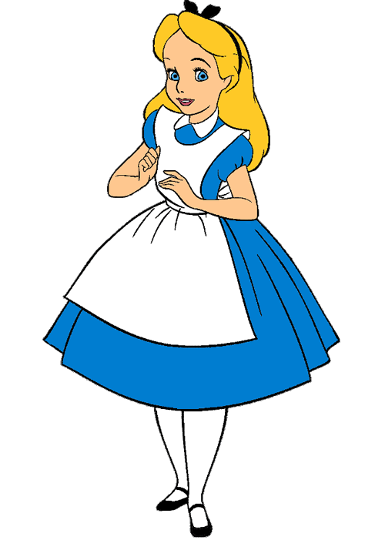
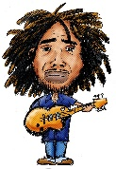
Alice
$$E$$
Bob

Slide 77
Alice
$$E$$
Bob

Slide 78
Alice
$$E$$
Bob

Slide 79
Alice
$$E$$
Bob

Slide 80
Alice
$$E$$
Bob

Slide 81
Alice
$$E$$
Bob

Slide 82
Alice
$$E$$
Bob

Slide 83
$$E_{A}$$
Alice
$$E$$
$$E_{B}$$
Bob

Slide 84
$$E_{A}$$
$$E_{A}$$
Alice
$$E$$
$$E_{B}$$
$$E_{B}$$
Bob

Slide 85
$$E_{A}$$
Alice
$$E_{A}$$
$$E_{B}$$
$$E$$
$$E_{B}$$
Bob

Slide 86
$$E_{A}$$
Alice
$$E_{A}$$
$$E_{B}$$
$$E$$
$$E_{B}$$
Bob

Slide 87
$$E_{A}$$
Alice
$$E_{B}$$
$$E_{A}$$
$$E$$
$$E_{B}$$
Bob

Slide 88
$$E_{A}$$
Alice
$$E_{B}$$
$$E_{A}$$
$$E$$
$$E_{B}$$
Bob

Slide 89
$$E_{A}$$
Alice
$$E_{B}$$
$$E_{A}$$
$$E$$
$$E_{B}$$
Bob

Slide 90
$$E_{A}$$
Alice
$$E_{B}$$
$$E_{A}$$
$$E$$
$$E_{B}$$
Bob

Slide 91
$$E_{A}$$
Alice
$$E_{B}$$
$$E_{A}$$
$$E$$
$$E_{B}$$
Bob

Slide 92
$$E_{A}$$
Alice
$$E_{B}$$
$$E_{A}$$
$$E$$
$$E_{B}$$
Bob

Slide 93
$$E_{A}$$
Alice
$$E_{AB}$$
$$E_{B}$$
$$E_{A}$$
$$E$$
$$E_{B}$$
Bob

Slide 94
Part V:
Supersingular Isogeny Diffie-Hellman

Slide 95
Using the full endomorphism ring of elliptic curves?
Remember: if $E/F_{p}$ is supersingular then
$$End_{F_{p}}\left(E\right)⊆End(E)$$
is strict and $End(E)$ is not commutative.
One always has $End_{F_{p^{2}}}\left(E\right)=End(E)$, however.
Jao and De Feo (and Plût) in 2010: can we somehow do Diffie-Hellman key exchange using supersingular elliptic curves over $F_{p^{2}}$, thereby defeating Kuperberg’s algorithm?

Slide 96
Supersingular isogeny graphs
(slide excerpts stolen from Frederik Vercauteren)

Slide 97
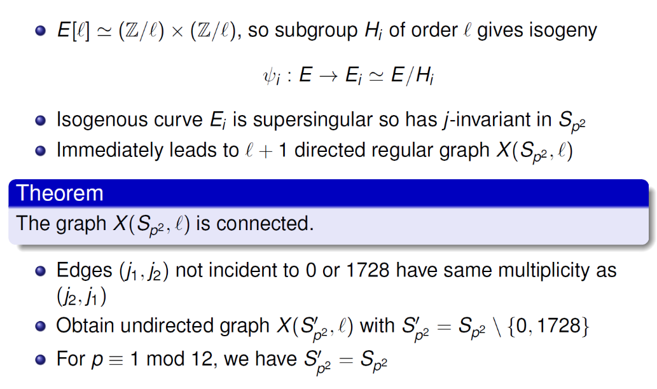
Supersingular isogeny graphs

Slide 98
Supersingular isogeny graphs

Slide 99
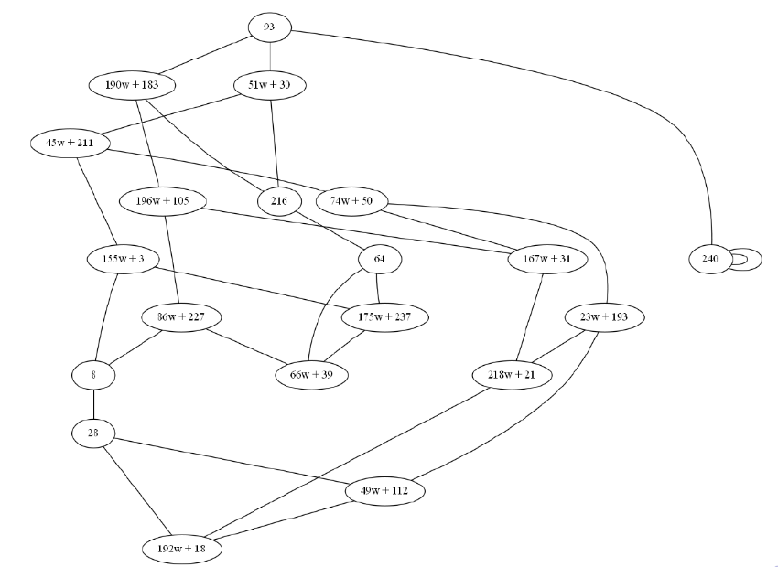
Supersingular isogeny graphs
$$ℓ=2$$

Slide 100
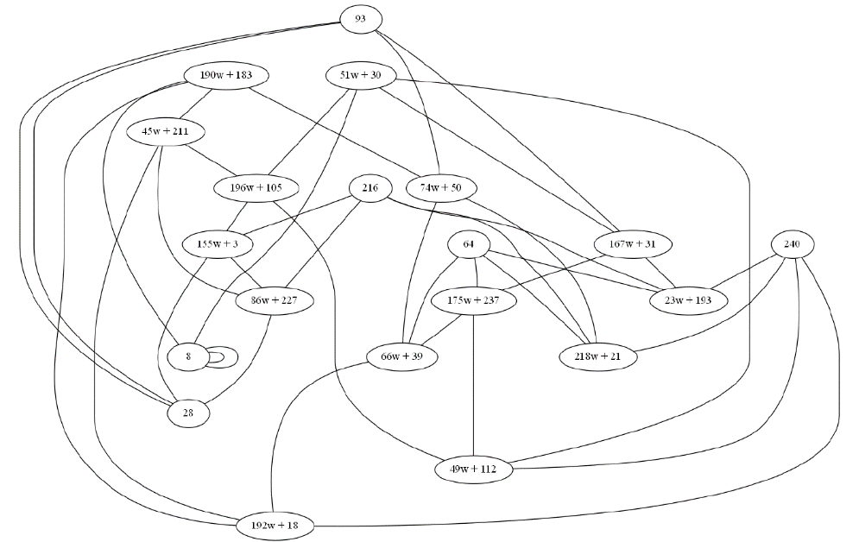
Supersingular isogeny graphs
$$ℓ=3$$

Slide 101
Supersingular isogeny graphs

Slide 102
Supersingular isogeny graphs
(still stealing from Frederik Vercauteren)

Slide 103
Jao and De Feo’s SIDH

Slide 104
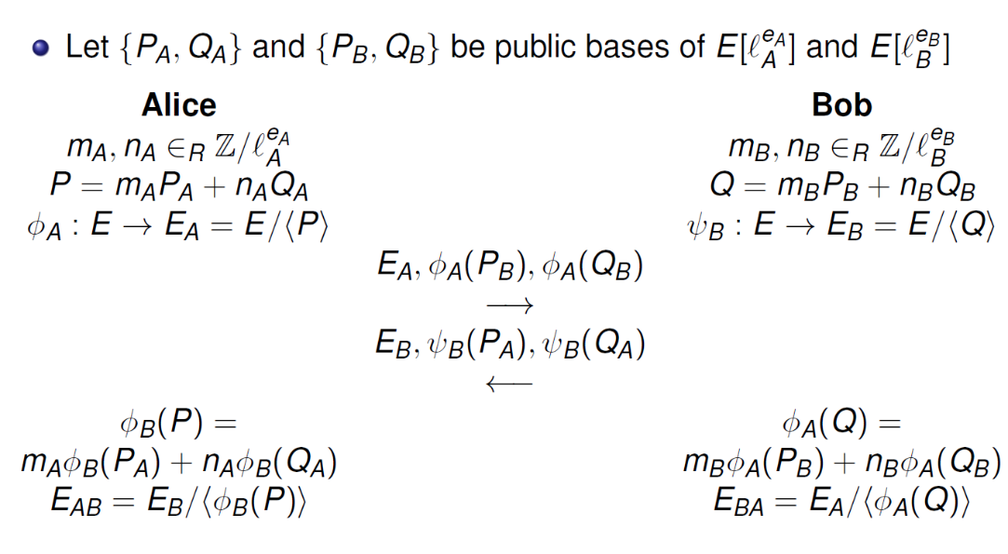
Jao and De Feo’s SIDH

Slide 105
Comparison CRS/CSIDH versus SIDH
(now stealing from Luca De Feo)

